Slide 1
CS 31006: Computer Networks – The Routers

Slide 2
The Life of a Router
Do
Find Path
Forward, forward, forward, forward, forward
Find Path
Forward, forward, forward, forward, forward
Repeat until powered off
Two basic operations –
Construct the routing table – the control plane
Do a routing match and forward the packet to a dedicated interface – the data plane

Slide 3
Evolution of Router Architecture
1st Generation (Until 1980’s): Standard Computer
2nd Generation (Early 1990’s): Delegate to interfaces
3rd Generation (Late 1990’s): Distributed Architecture
4th Generation (Early 2000’s): Distributed over multiple racks
5th Generation (Today): Software Defined Routing

Slide 4
Basic Architectural Components of a Router
Processor
Memory
CPU
Interconnection Network
Interface card
Interface card
Interface card
Interface card

Slide 5
Router Hardware
Processor is responsible for control functions (route processors)
Construct the routing table based on the routing algorithm
Forwarding is done at the interface card
Route match needs to be very fast
Specialized hardware – Ternary Content-Addressable Memory (TCAM)
Control Plane
Routing Table Construction
Data Plane
Forwarding

Slide 6
Router Internals

Slide 7
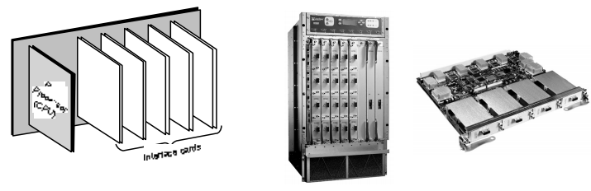
Slotted Chassis – The Physical Infrastructure for Routers
Large routers are built as slotted chassis
Interface cards are inserted in the slots
Route processor is also inserted at a slot
Simplifies repairs and upgrades of components

Slide 8
Functional Components
Routing Functions
Table
Update
Control
 | Routing Table
Route Lookup
Datapath
Per Packet Processing
IP Forwarding

Slide 9
Control Plane in a Router
Note that a router is a special purpose computer
Implemented as a software (router OS) that supports the basic computing functionalities to run a router along with routing functionalities
Routing protocols are implemented in the router OS
Example: Cisco IOS

Slide 10
Routing Functions
Route Calculation
Maintenance of the routing table
Execution of the routing protocol
On commercial routers, routing functions are handled by a single general purpose processor, called the route processor

Slide 11
Data Plane of a Router
Implement forwarding functionalities – make a route lookup and forward the packet at the destination interface
Functionality is similar to a L2 switch – use switch fabric (the mapping from input ports to output ports) to forward the packet from one interface to another
Maintains interface buffer – to implement store and forward functionality

Slide 12
IP Forwarding
Per packet processing of the IP packets
IP forwarding is distributed, handled by individual interface controllers
Special hardware devices are used - TCAM

Slide 13
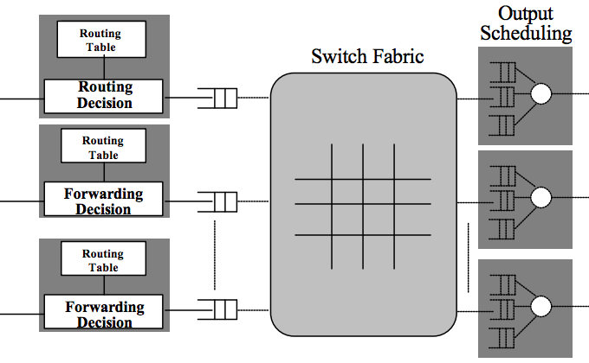
Per Packet Processing – Basic Architectural Components
Routing Table

Slide 14
Forwarding Information Base (FIB)
The interfaces maintains a forwarding information base (FIB) – a mapping from input interface to output interface
A replica of the routing table used at the interfaces for making the forwarding decision
Routing Protocols
Route Lookup
Input Interface
FIB Lookup
FIB MISS
PACKET_IN
FIB HIT
Forward Packet
Output
Interface
PACKET_OUT

Slide 15
Difference between RIB and FIB
Routing Information Base (RIB) – The routing table, implemented in software, is maintained at the control plane
Forwarding Information Base (FIB) – The copy of the required routes maintained in interface TCAM hardware
RIB is dynamic and maintains entire routing information, FIB is updated whenever required

Slide 16
RIB and FIB
The RIB
172.16.1.0 | 255.255.255.0 | 172.16.1.2 | Eth0
172.16.2.0 | 255.255.255.0 | 172.16.2.2 | Eth1
10.3.0.0 | 255.255.0.0 | 10.3.1.1 | Eth3
10.9.0.0 | 255.255.0.0 | 10.9.1.1 | Eth4
172.16.2.0 | 255.255.255.0 | 172.16.2.2 | Eth1
10.3.0.0 | 255.255.0.0 | 10.3.1.1 | Eth3
10.9.0.0 | 255.255.0.0 | 10.9.1.1 | Eth4
FIB at Eth1
FIB at Eth0
172.16.1.0 | 255.255.255.0 | 172.16.1.2 | Eth0
10.3.0.0 | 255.255.0.0 | 10.3.1.1 | Eth3

Slide 17
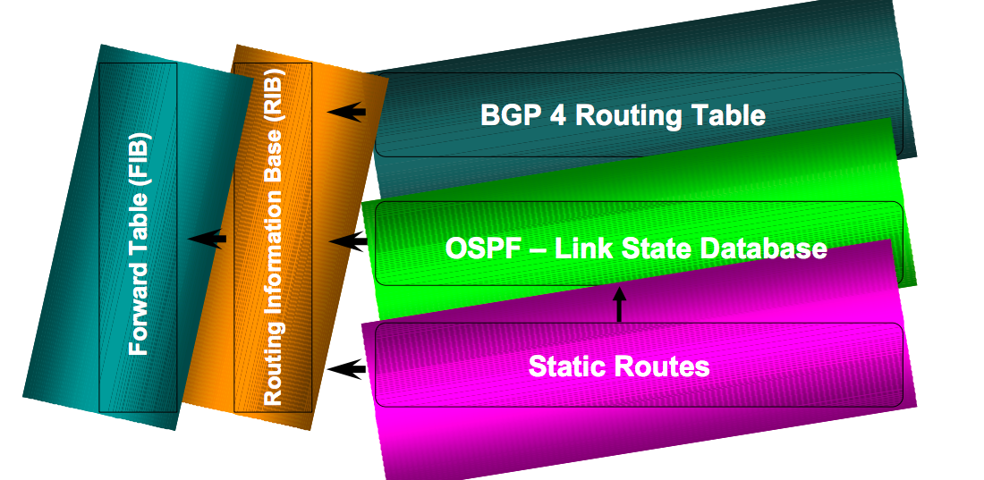
RIB Feeds FIB
Image source: Cisco

Slide 18
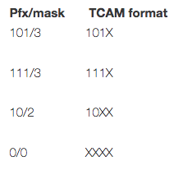
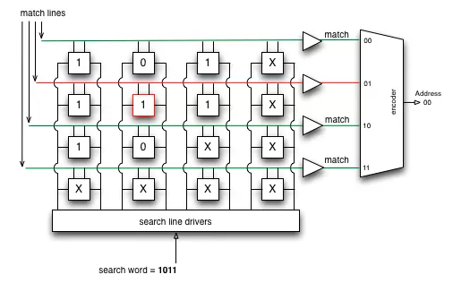
Basic TCAM Architecture
Image Source: http://thenetworksherpa.com/tcam-in-the-forwarding-engine/

Slide 19
Basic TCAM Architecture
Image Source: http://thenetworksherpa.com/tcam-in-the-forwarding-engine/
Let us try to match 1010

Slide 20
Basic TCAM Architecture
Image Source: http://thenetworksherpa.com/tcam-in-the-forwarding-engine/
1
Let us try to match 1010

Slide 21
Basic TCAM Architecture
Image Source: http://thenetworksherpa.com/tcam-in-the-forwarding-engine/
1
1
Let us try to match 1010

Slide 22
Basic TCAM Architecture
Image Source: http://thenetworksherpa.com/tcam-in-the-forwarding-engine/
1
1
1
Let us try to match 1010

Slide 23
Basic TCAM Architecture
Image Source: http://thenetworksherpa.com/tcam-in-the-forwarding-engine/
1
1
1
1
Let us try to match 1010

Slide 24
Basic TCAM Architecture
Image Source: http://thenetworksherpa.com/tcam-in-the-forwarding-engine/
1
0
1
1
1
Let us try to match 1010

Slide 25
Basic TCAM Architecture
Image Source: http://thenetworksherpa.com/tcam-in-the-forwarding-engine/
1
0
1
1
1
1
Let us try to match 1010

Slide 26
Basic TCAM Architecture
Image Source: http://thenetworksherpa.com/tcam-in-the-forwarding-engine/
1
0
1
1
1
0
1
0
Let us try to match 1010

Slide 27
Basic TCAM Architecture
Image Source: http://thenetworksherpa.com/tcam-in-the-forwarding-engine/
1
0
1
0
1
1
1
0
1
0
1
0
1
0
Let us try to match 1010

Slide 28
Basic TCAM Architecture
Image Source: http://thenetworksherpa.com/tcam-in-the-forwarding-engine/
1
0
1
0
1
1
1
0
1
0
1
0
1
0
Let us try to match 1010

Slide 29
Software Defined Networking
Software-defined networking (SDN) is a network framework which involves in separating a network's control functions from its data forwarding functions, centralizing its intelligence, and abstracting its underlying architecture from applications and services.
Indian Institute of Technology Kharagpur

Slide 30
Control and Data Plane
Control plane
The module which takes all decisions, basically an instructor
The routing algorithm
Data plane
The module which carries out the tasks given by the control plane
Forwarding of Packets
Indian Institute of Technology Kharagpur

Slide 31




Control and Data Plane
Traditional networking devices are proprietary
Vendors decide software (control plane) and hardware (data plane)
No standardization
These two modules are “baked” in
Unchangeable
Indian Institute of Technology Kharagpur

Slide 32
What does separating control and data plane mean?
But what if they were separate?
Vendors only provide the hardware (data plane)
We decide the control plane by writing custom logic – the software
Indian Institute of Technology Kharagpur

Slide 33
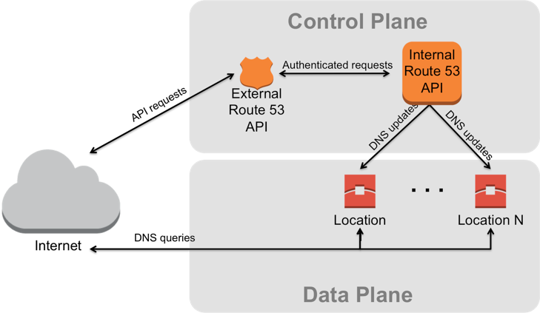
What does separating control and data plane mean?
But what if they were separate?
Vendors only provide the hardware (data plane)
We decide the control plane by writing custom logic
Advantages:
Features are no longer limited to what the vendor provides
Community development
Longer life of products
Indian Institute of Technology Kharagpur

Slide 34
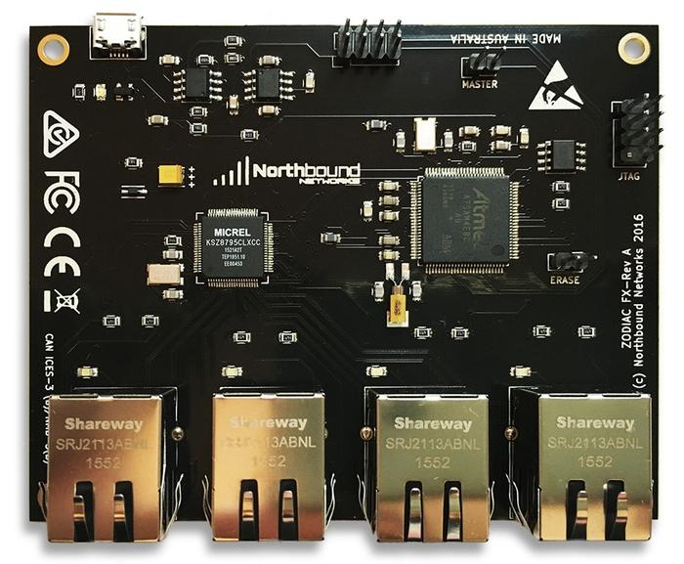
How Does SDN Work
Compared to traditional networks, a software defined network has 2 types of devices
Controller
Switches
The switches in SDN are blind
No built-in features
Need to be instructed by the controller
Zodiac FX - A Tiny SDN Switch
Indian Institute of Technology Kharagpur

Slide 35
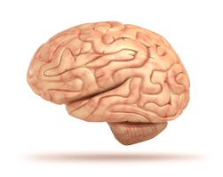
SDN Controller
“Brains” of the network
All policies, routing logic are placed in the controller
“Teaches” the switches what to do with an unknown packet
c0
s1
h1
h3

Slide 36
SDN Controller
“Brains” of the network
All policies, routing logic are placed in the controller
“Teaches” the switches what to do with an unknown packet
c0
Let us now see a scenario where a packet wants to go from h1 to h3 in an SDN environment
s1
h1
h3

Slide 37
Forwarding Request from h1 to s1
c0
s1
SRC - h1
DST - h3
h1
h3

Slide 38
Table Miss at s1
No rule is there for h1->h2 at the beginning, so a FIB miss at S1
c0
Table MISS
s1
?
h1
h3

Slide 39
Packet-IN to Controller
The controller generates the rule based on a software program (the routing logic)
Packet-IN
c0
Table MISS
s1
Till then, the packet is buffered at s1
?
Packet-OUT
h1
h3

Slide 40
Flow Rule Set at s1…
The rule is installed at the FIB of S1
c0
Rule 1
s1
h1
h3

Slide 41
All Future Packets from h1->h3
The buffered packet is forwarded based on that rule
c0
Rule 1
s1
h1
h3

Slide 42
Buffered Packet Forwarded to h3…
All the future packets from h1->h2 follow the same rule
c0
Rule 1
s1
h1
h3

Slide 43
The SDN Architecture
Image source: qmonnet.github.io

Slide 44
Tranditional Network vs SDN
Image source: http://opensourceforu.com/

